Slide 1
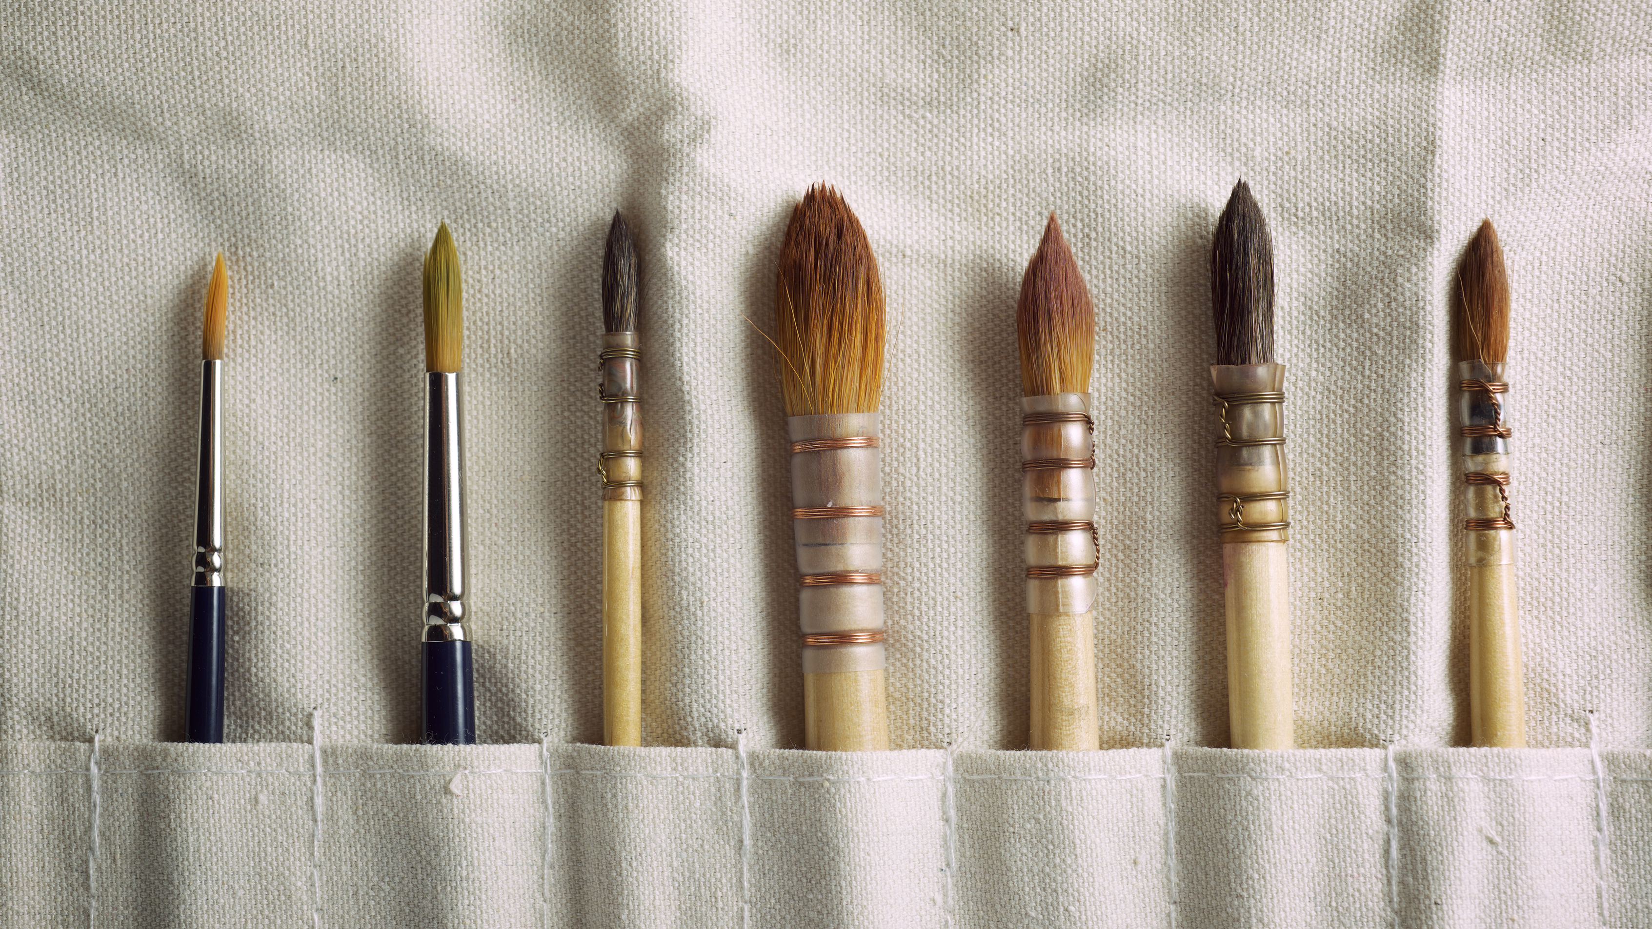
Care and Handling of the Paint Brush

Slide 2
Brush rules
1.) Keep brushes in water
2.) Do not paint past the ferrule
3.) Always wash after use
4.) Do NOT leave in sink

Slide 3
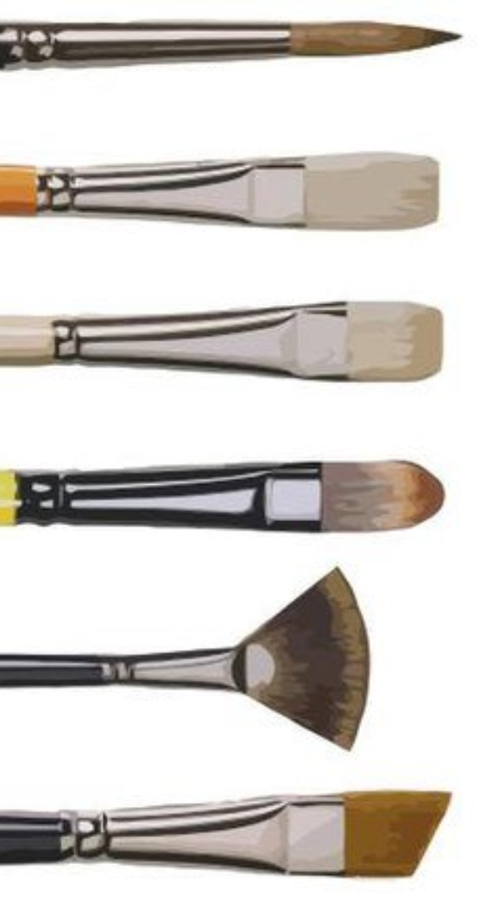
Types of brushes
Round – Used for detail
Flat – Used for spreading paint quickly and evenly
Bright – Used like a flat brush but for bolder brush strokes
Filbert – Domed edges for good coverage and blending
Fan – Used to create texture
Angle – Used for corners and sharp lines

Slide 4
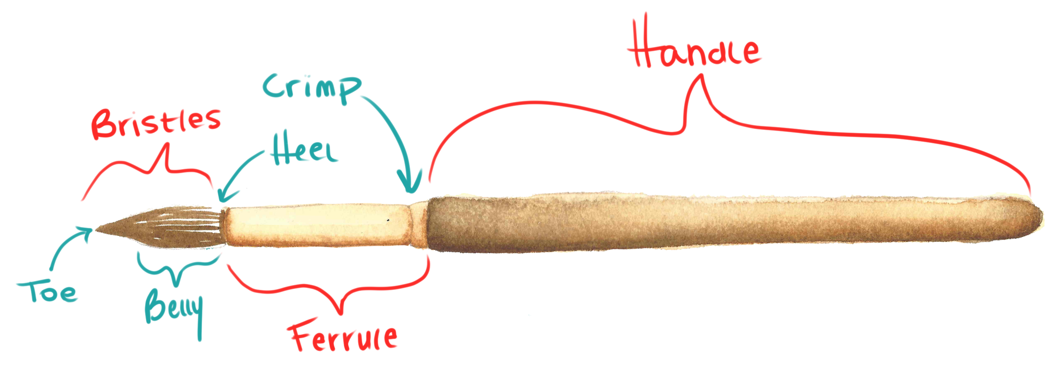
Parts of the Brush

Slide 5
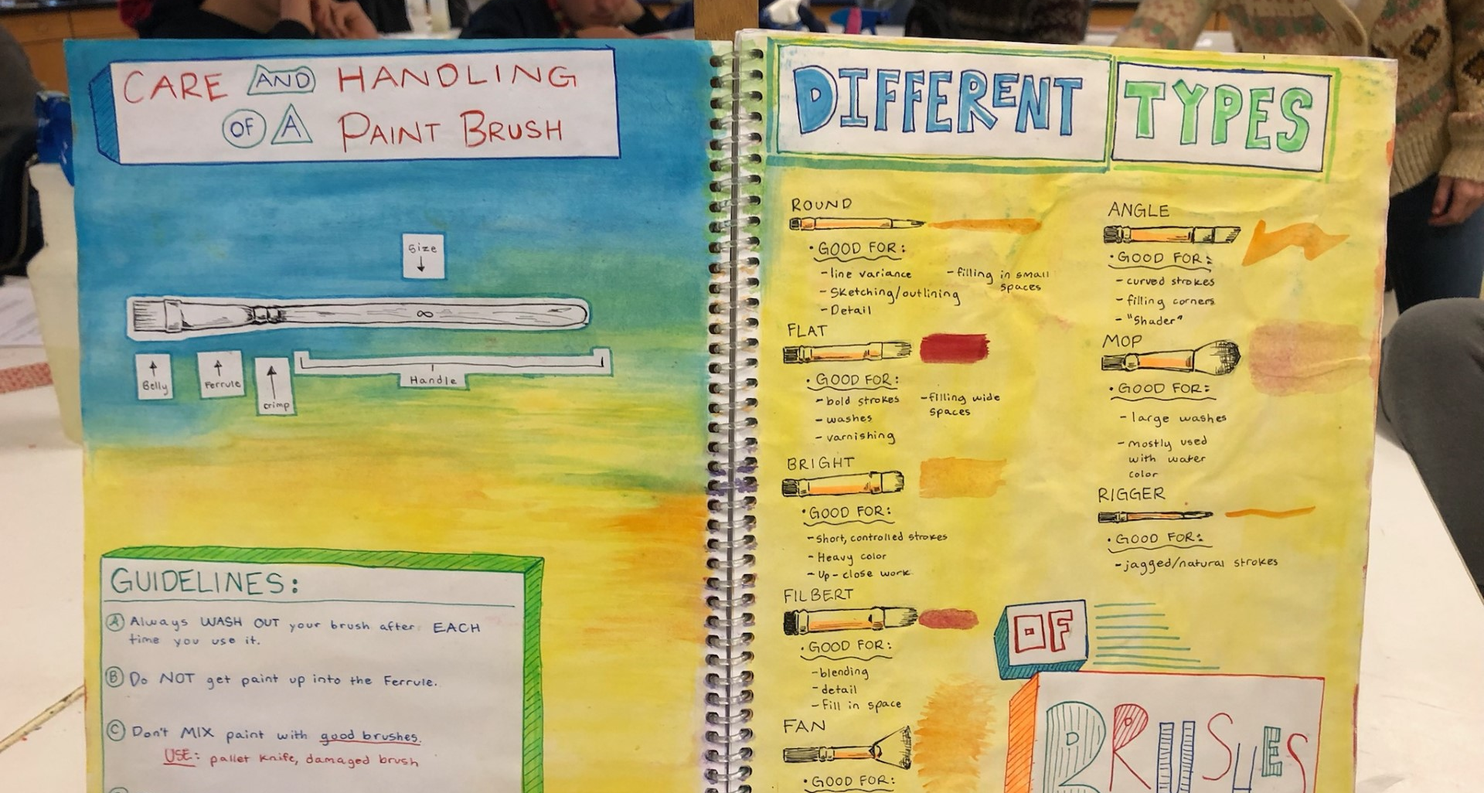
Sketchbook 2: Care of the Brush

Slide 6
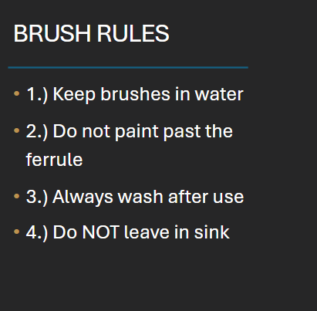
Sketchbook 2: Care of the Brush

