Slide 1
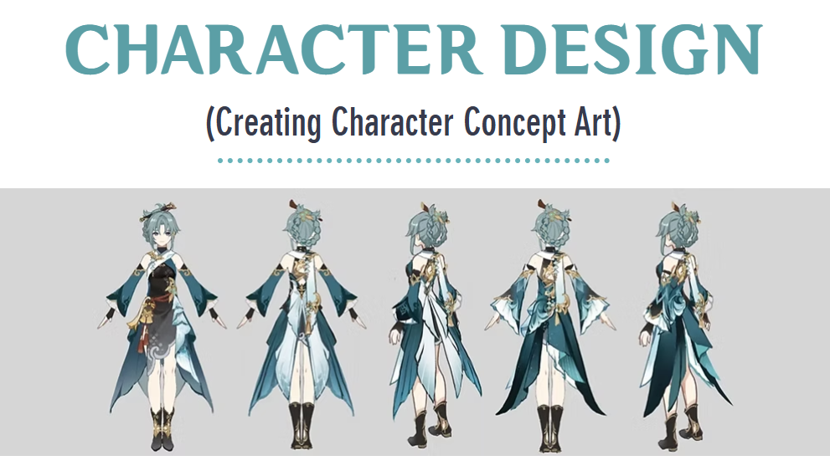

Slide 2
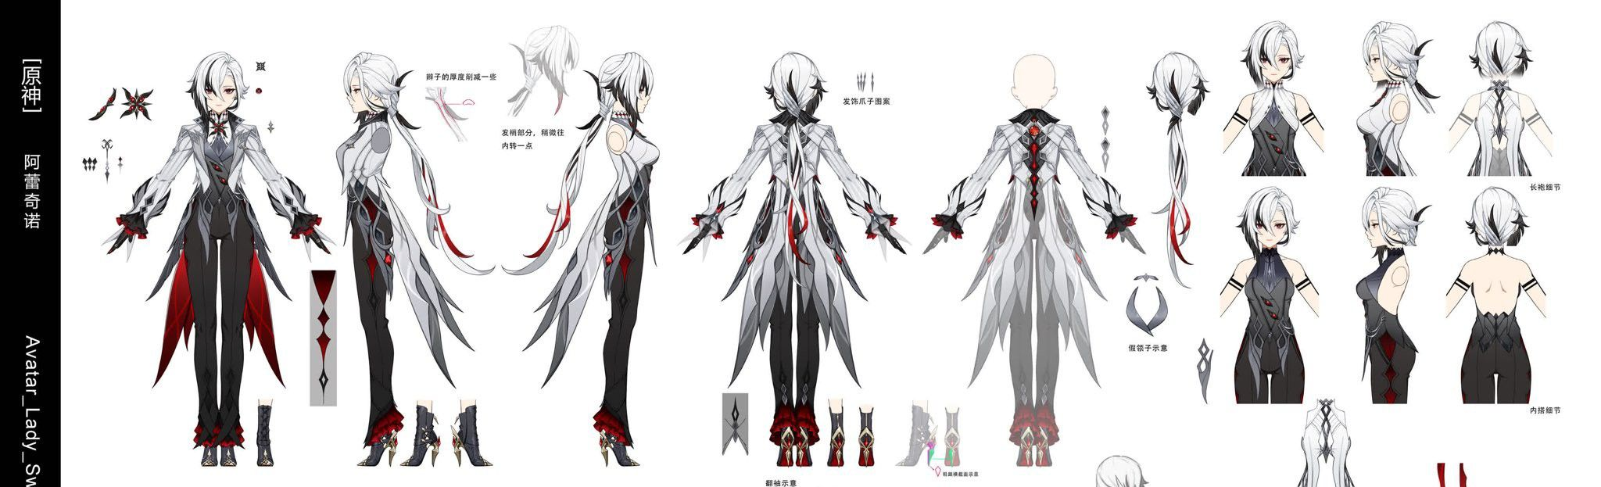
What is concept art?…
Concept art for character design is the initial visual exploration of a character’s appearance, personality, and role within a story or world. It involves creating rough sketches, designs, and mood boards to explore different looks, outfits, and expressions, helping to establish the character's identity.
Concept art serves as a blueprint for final designs, offering a creative foundation for animators, illustrators, and other artists to build upon in the development of the character, including outfit layers, jewelry, accessories, hairstyles, and other design details.

Slide 3
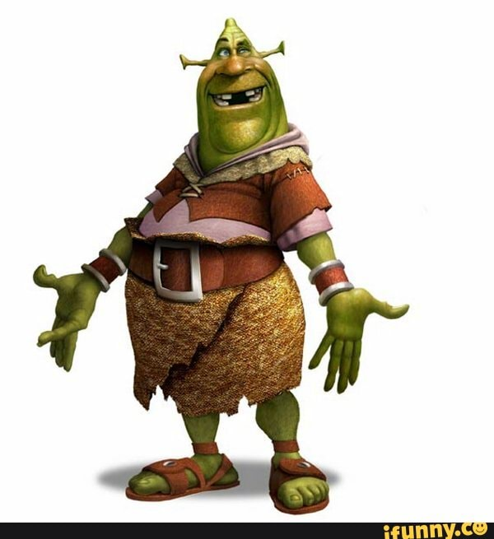

Slide 7
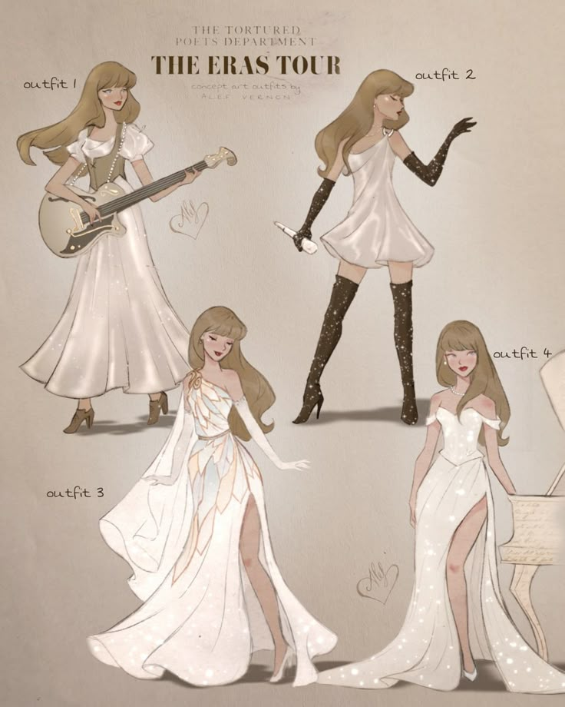

Slide 8
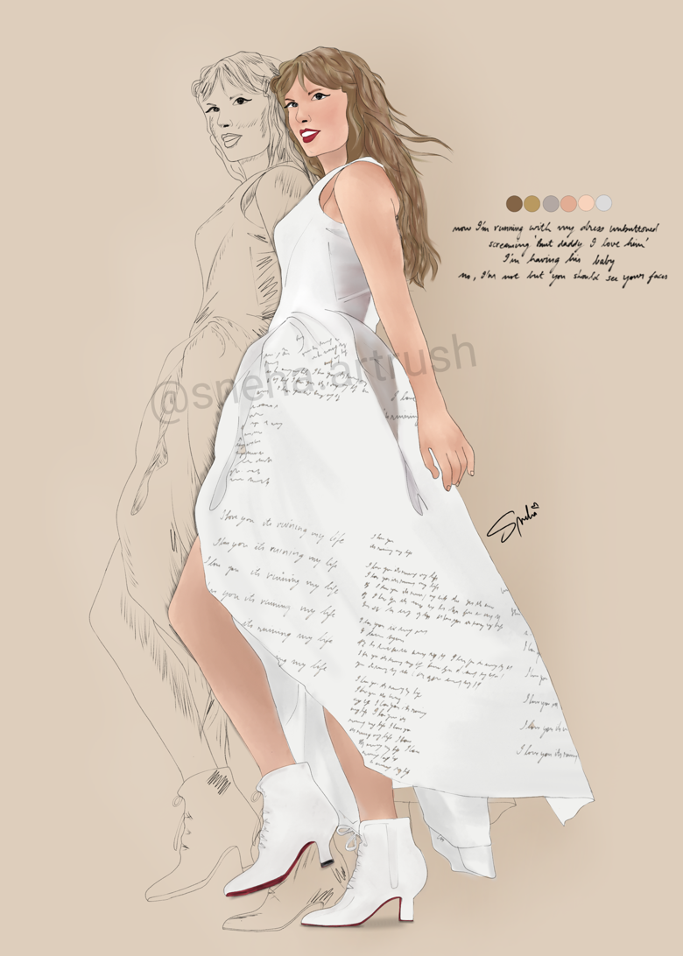

Slide 10
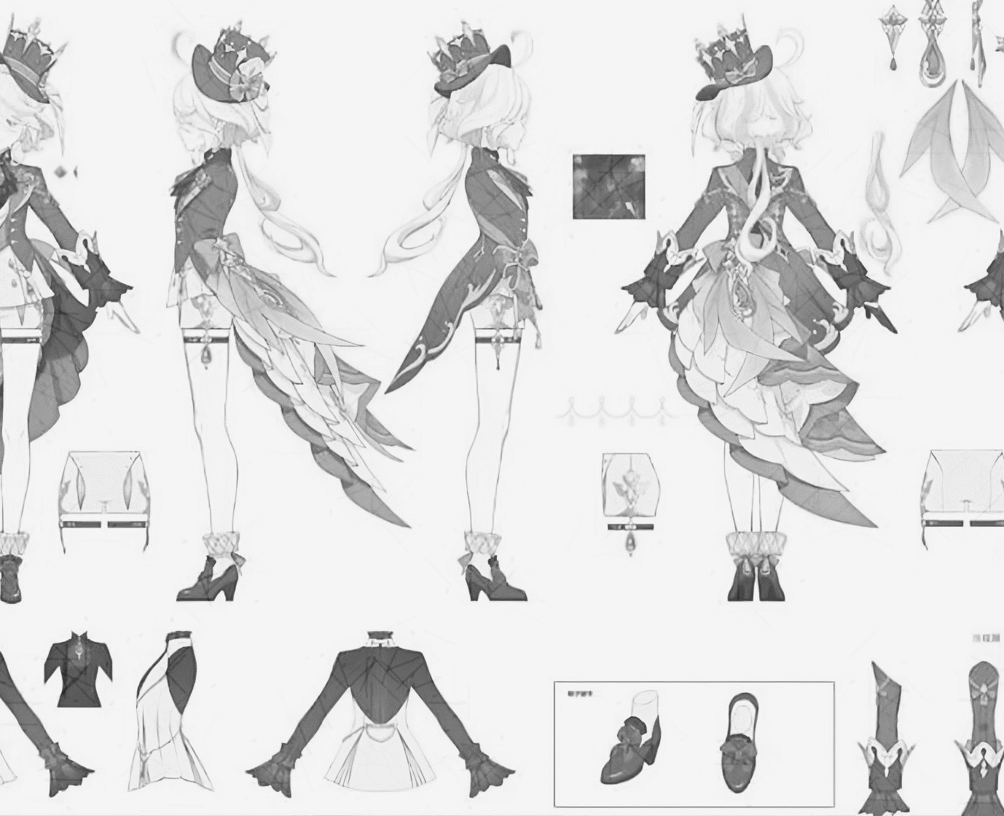
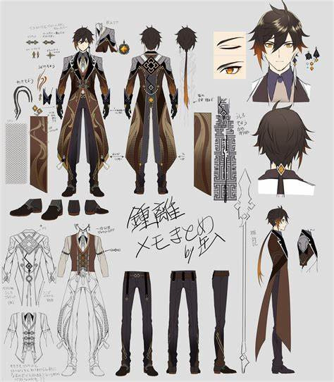
Artists creating concept art for character design have to carefully consider every aspect of the design. This could include:
Cultural/Regional Influences

Slide 11
Artists creating concept art for character design have to carefully consider every aspect of the design. This could include:
Cultural/Regional Influences
Where is the character from?
What kind of traditional clothing comes from this location?
What is the weather like?
What accessories might they carry?
Are there symbols or patterns that fit the aesthetic of the region?

Slide 12
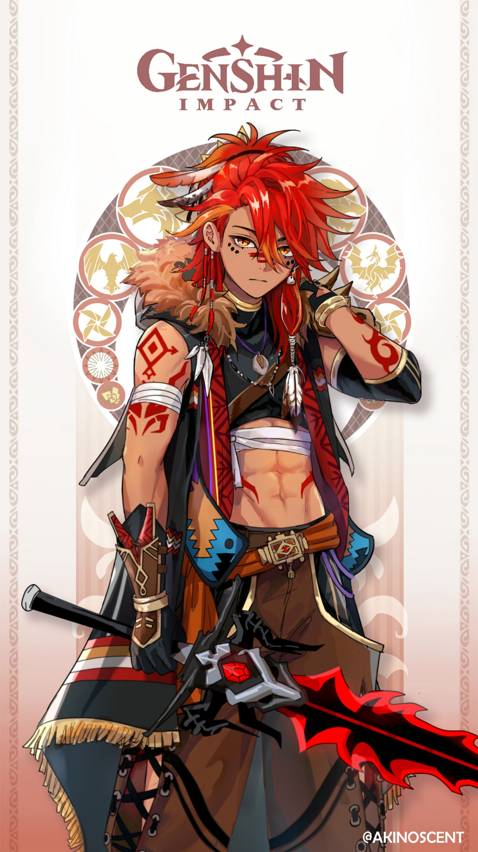
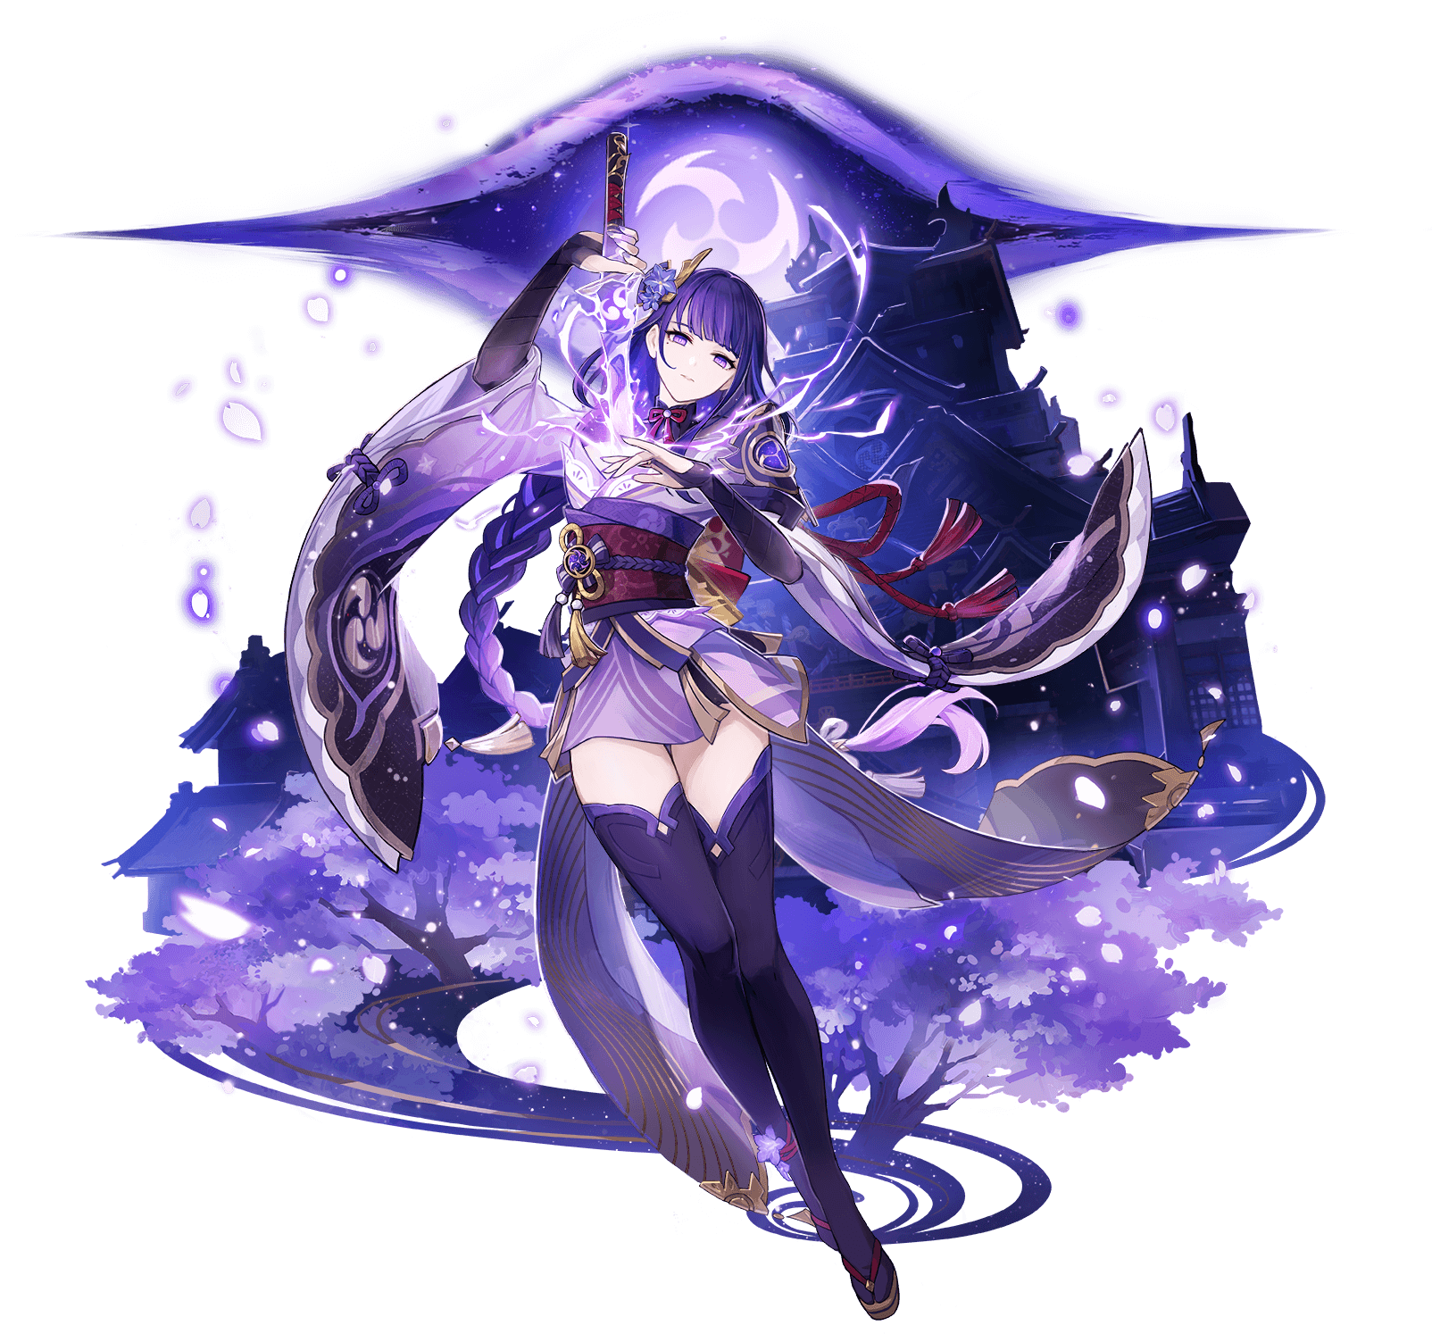
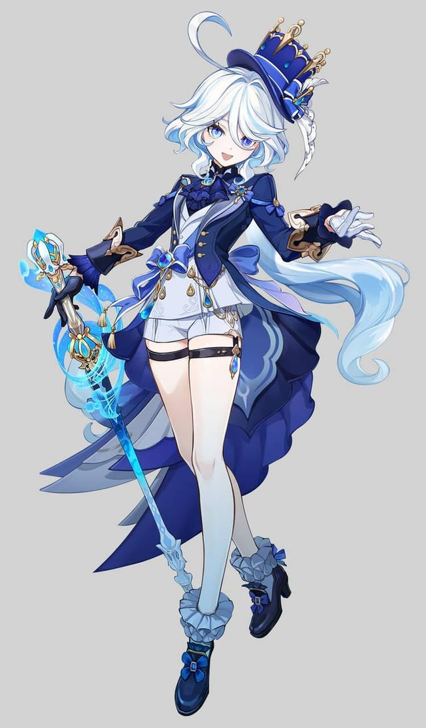

Slide 13
Artists creating concept art for character design have to carefully consider every aspect of the design. This could include:
Cultural/Regional Influences
Skills/Combat/Powers

Slide 14
Artists creating concept art for character design have to carefully consider every aspect of the design. This could include:
Cultural/Regional Influences
Skills/Combat/Powers
What kind of weapon does the character use?
Is it associated with something like fire, water, lightening, etc?
How does this effect the characters outfit? For example an archer might carry a quiver, or a swordsman might have a sheath.

Slide 15
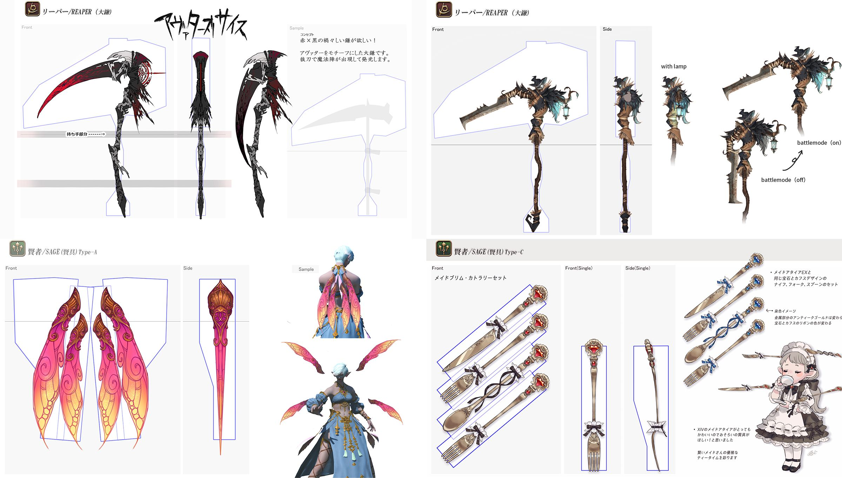

Slide 16
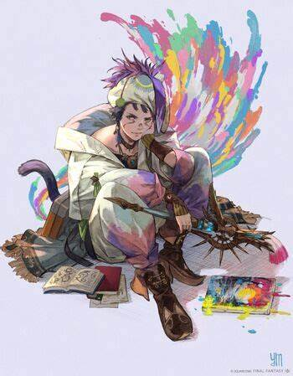
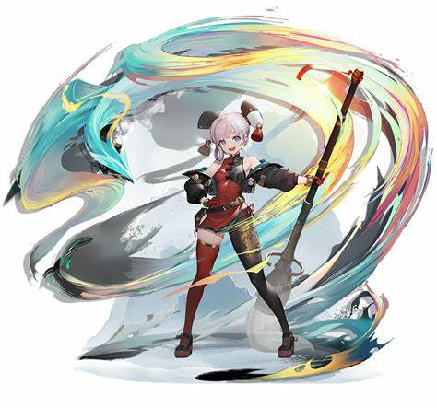

Slide 17
Artists creating concept art for character design have to carefully consider every aspect of the design. This could include:
Cultural/Regional Influences
Skills/Combat/Powers
Color Schemes

Slide 18
Artists creating concept art for character design have to carefully consider every aspect of the design. This could include:
Cultural/Regional Influences
Skills/Combat/Powers
Color Schemes
Just by glancing at a characters’ color pallet, an artist gets a glimpse into the personality of the character. Pastels may feel more soft and child-like, while dark, cool colors show a moodiness.
Is your character softspoken? Loud? Good? Evil? Neutral? Kind? Snarky?

Slide 19
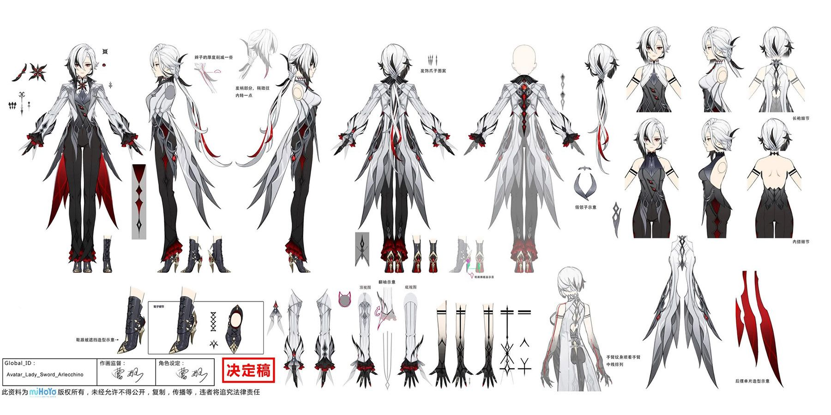

Slide 21
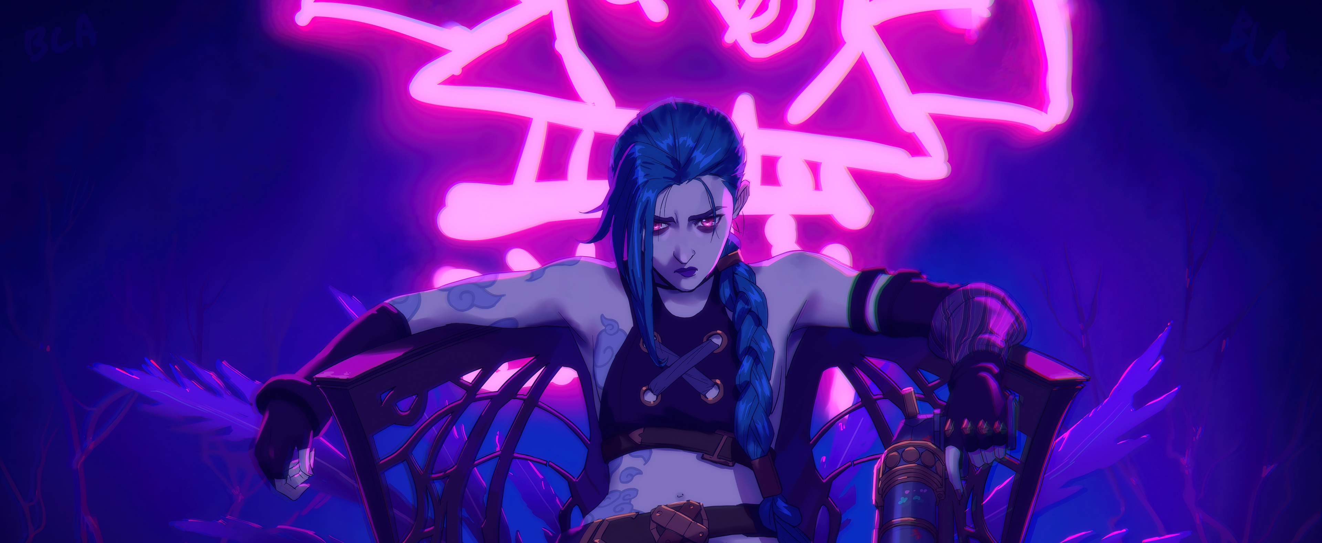
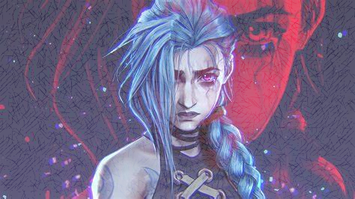
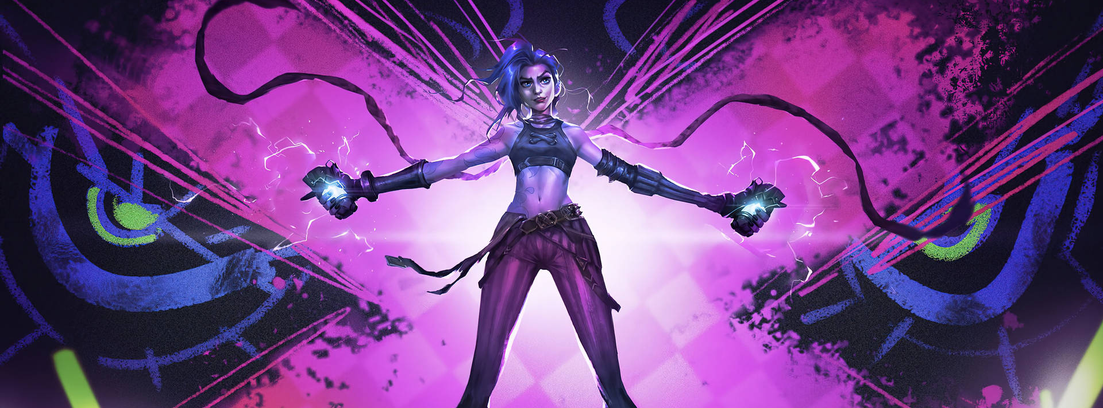

Slide 22
Artists creating concept art for character design have to carefully consider every aspect of the design. This could include:
Cultural/Regional Influences
Skills/Combat/Powers
Color Schemes
Silhouette

Slide 23
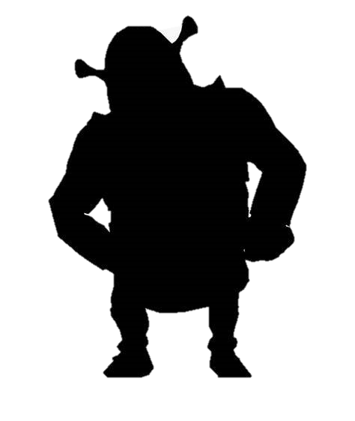
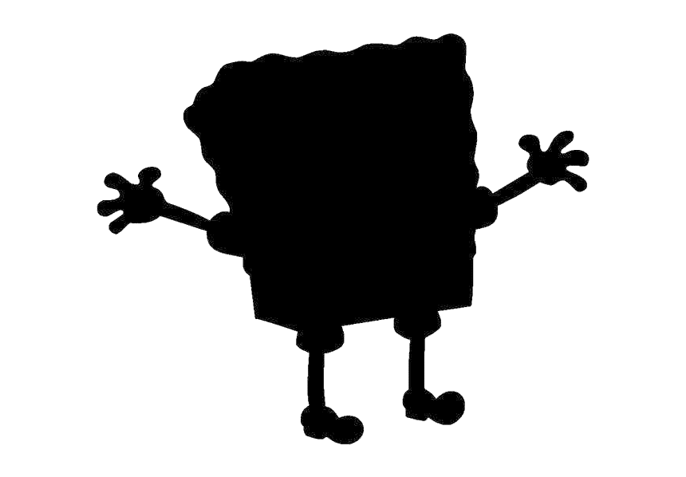
Artists creating concept art for character design have to carefully consider every aspect of the design. This could include:
Cultural/Regional Influences
Skills/Combat/Powers
Color Schemes
Silhouette
A strong, recognizable silhouette is essential in character design. A silhouette that is easy to identify helps make the character visually distinct and memorable.

Slide 24
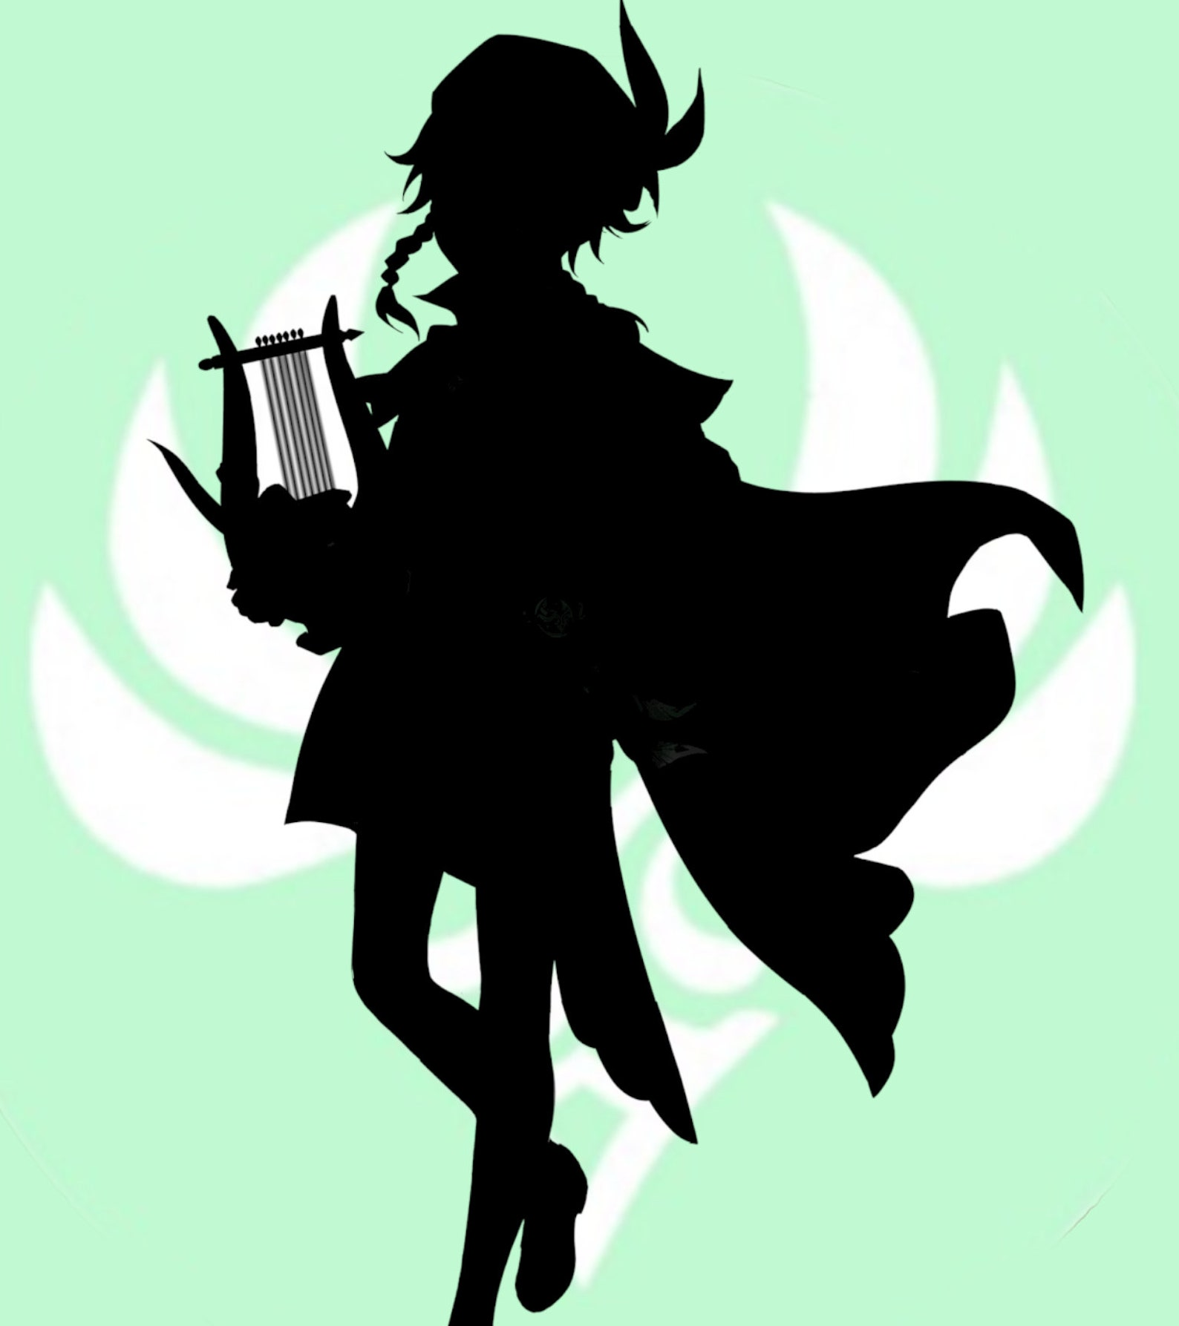

Slide 25
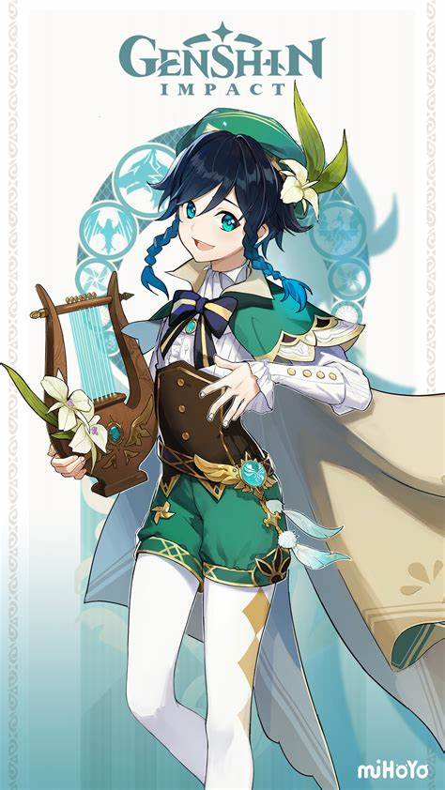

Slide 26
Artists creating concept art for character design have to carefully consider every aspect of the design. This could include:
Cultural/Regional Influences
Skills/Combat/Powers
Color Schemes
Silhouette
Emotions/Personality
The visual design should reflect the character’s traits. For example, a tough, rebellious character might have a more rugged, angular look with bold features, while a gentle, wise character might have softer, rounded lines and a more serene expression.

Slide 27
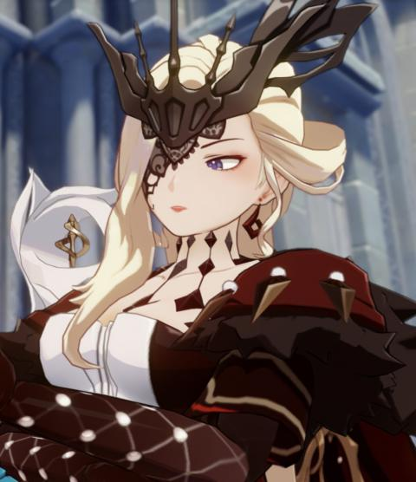
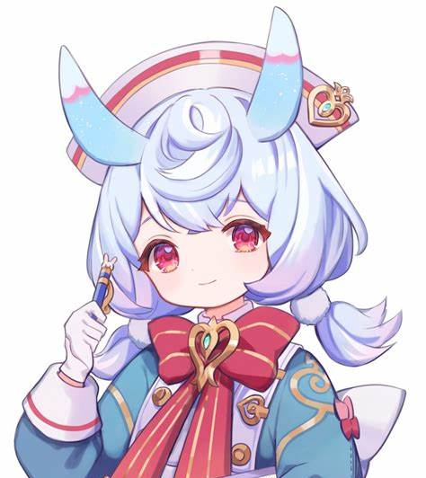

Slide 28
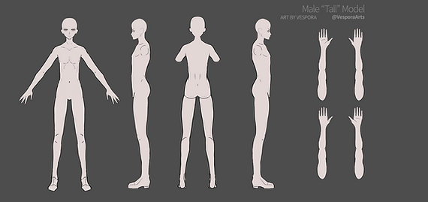
After an artist has concepts of WHO the character is, it's time to put the "concept" into art.
Many games or cartoons have a specific art style or template for how the character will look. This is to keep the art style across the medium. For example, to the right is a "base" body to build up from. This is often done in a "T-pose" from multiple angles to fully showcase every aspect of the character design.
You will be choosing one of 5 options as your characters "base" body, then building layers of the outfit, adding designs, colors, weapons, accessories, and more to build the character and bring it to life. As depicted below, this process can take many attempts until the character is just right.

Slide 29
You will experiment through a series of detailed sketches and color explorations, crafting a unique character that evolves; reflecting their environment, background, and purpose.

Slide 30
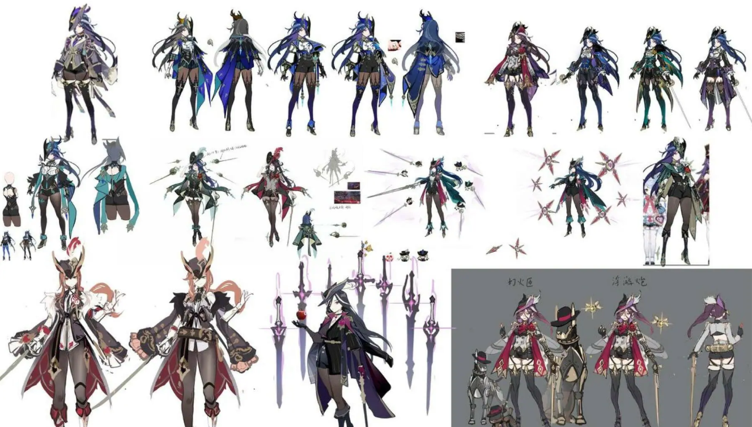

Slide 31
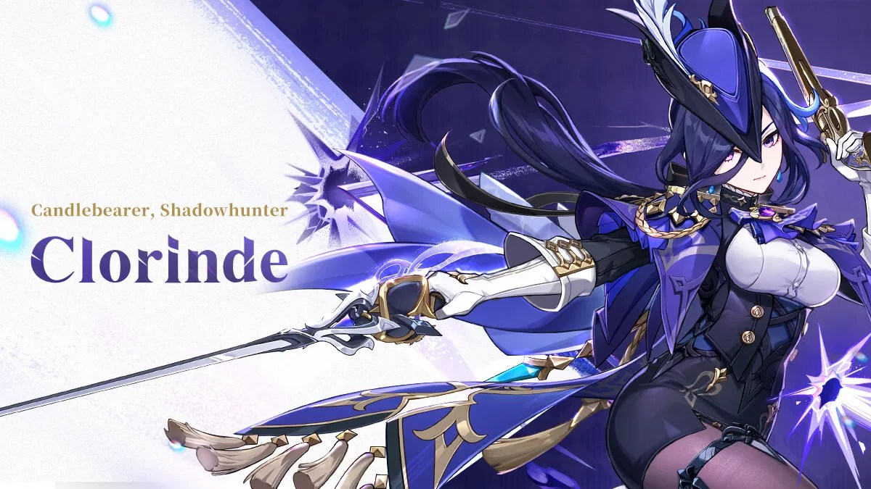

Slide 32
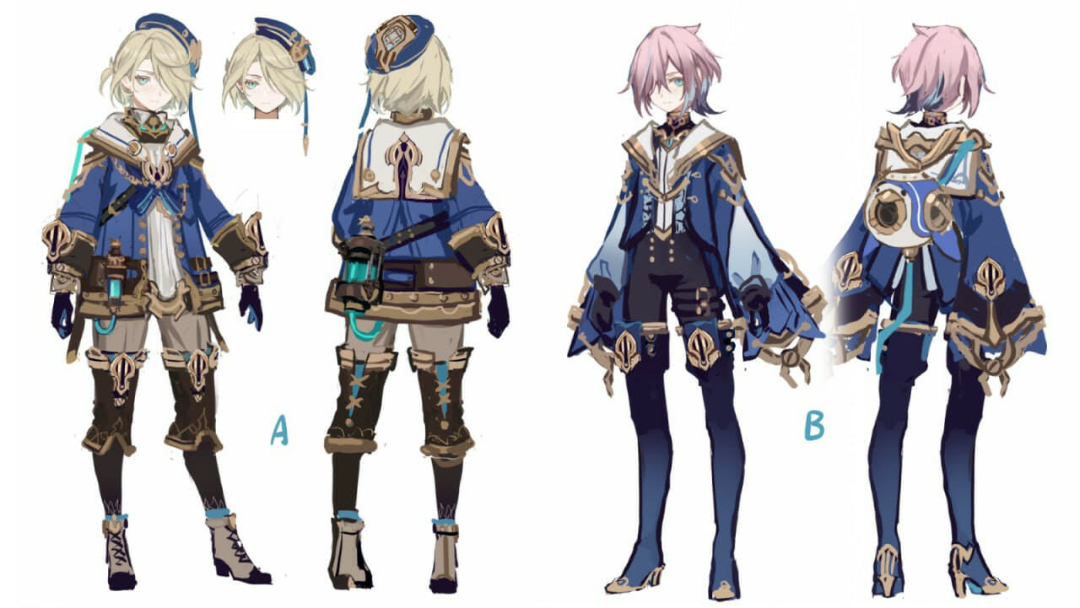

Slide 33
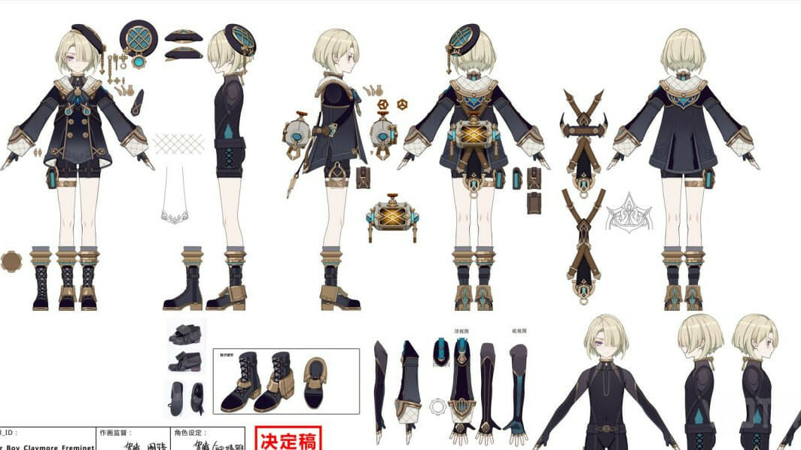

Slide 34
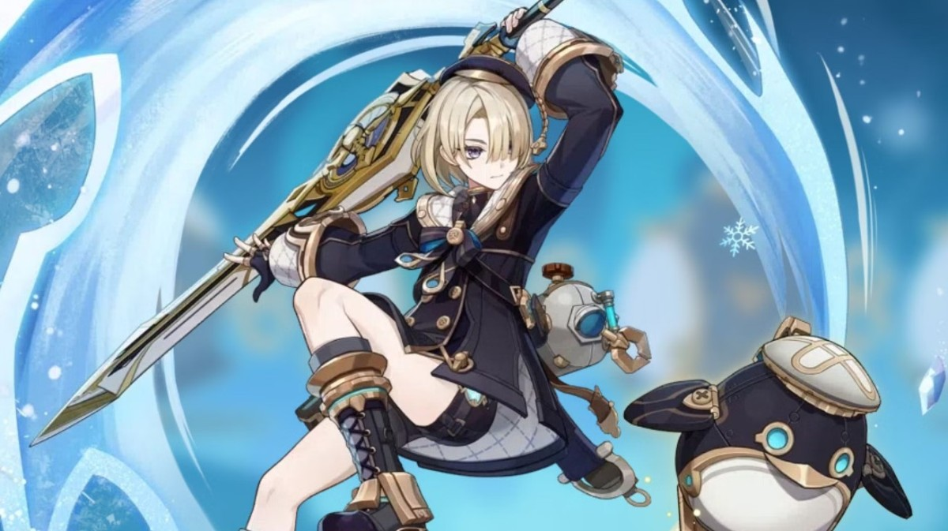

Slide 35
